Slide 1
Why are you here? You all have something in common…what is it?

Slide 2
Benefits to taking AP classes in High School
Prep for College
Rise to the top of the pile
Strengthen your transcript
Study what you love or explore new interest
Get a head start to save and earn $$$
Gain life skills to improve employment opportunities

Slide 3
What other AP courses can I take?
Check with your counselor for guidance on the courses you are most set up for success with.
What do you have in interest in?
What are some of your friends taking?
What courses align with your goals after high school?
AP Computer Science Principles
AP Psychology
*AP Capstone

Slide 8
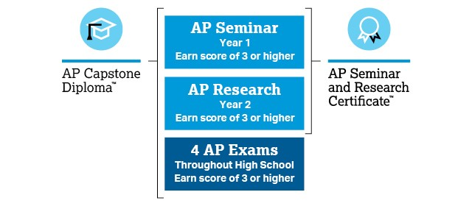
AP Capstone

Slide 9
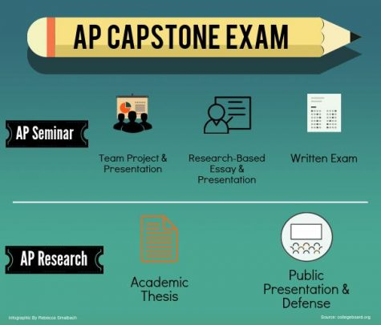
AP Capstone

Slide 10
Largo HS AP course offerings
European History
World History
Human Geography
US History
Psychology
Statistics
Government and Politics
Economics
Physics
Computer Science Principles
Biology
Environmental Science
Calculus
English Literature
English Language
Environmental Science
Spanish Language
Spanish Literature
Art & Design (2D/3D)
Drawing
Music Theory

Slide 11
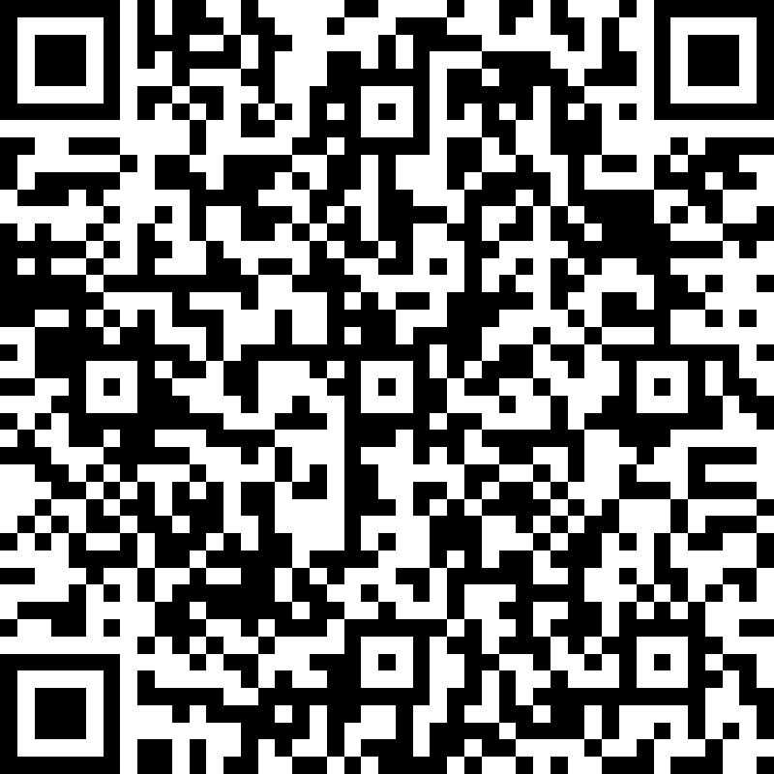
Sign out Survey

Slide 12
Thank you!

Slide 13
Editable Icons by Omar López

